Slide 1
Social Ads Forecasting
By Tang Aik Ying
DS-Uncut-3.0

Slide 2
Background Of Study
Advertising is important for a business, to
Communicate important information to customers
Reach out both existing and potential customers
Gain business profit
Objectives:
To analyse the relationship of the expenses in social ads platform with their sales
To establish a regression model

Slide 3
Overview of Data Set
Descriptions of columns:
1. segment - market which is being transformed into id
2. google
3. facebook platform (amount that spend into these platform (thousands in dollar) )
4. instagram
5. sales - amount of sales (thousands in units)
6. size - size of the market (large or small)
7. area - type of market (rural, urban, suburban)

Slide 4
About Advertising Platform
“Facebook offers the ability to target highly specific audiences that can be easily customized to fit your business’ needs. If you have a local business or if your target audience is based in a specific same city, then geotargeting is the solution for you.”
The Google ads platform is different from Facebook ads as it’s based almost entirely on keywords and search terms.
In a way, people are actively requesting information about something they want to know more about.
Instagram ads help to show relevant ads to your target audience on this popular social media. Both image ads and video ads work well on Instagram because both of these tend to stand out more than text ads.
References: 13 Best Digital Advertising Platforms of 2021 (Ultimate Guide) (adamenfroy.com)

Slide 5
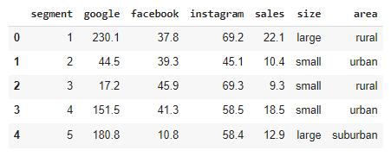
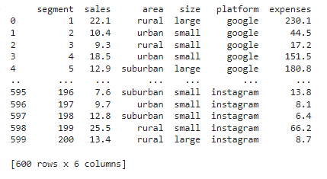
Exploratory Data Analysis(EDA)
Restructure data
Platform – google, facebook, instagram
Expenses – value from google, facebook, instagram

Slide 6
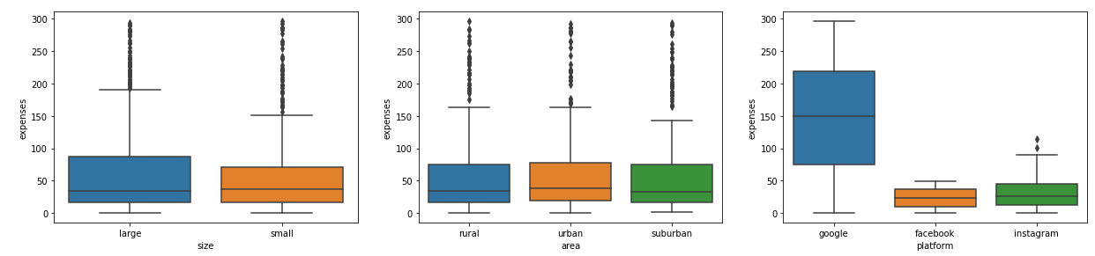
Boxplot
Observation:
For size and area, median of the box plot is more likely the same
For platform,
facebook and instagram have more likely same median
Google is having higher spread of expenses compared to facebook and instagram

Slide 7
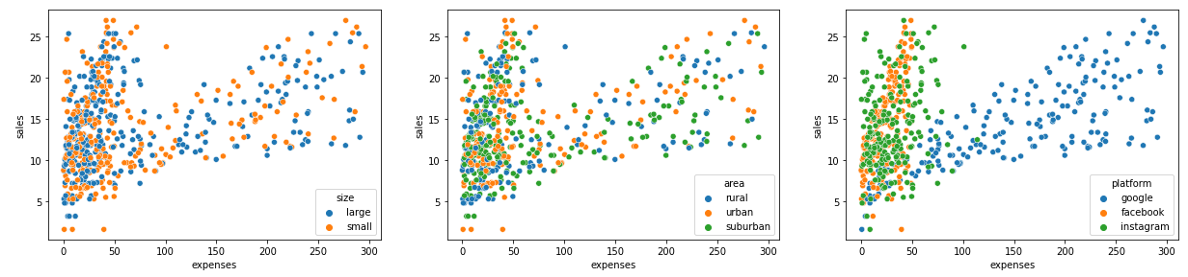
Scatter Plot
Observation:
Data set is more focused on expenses that range from 0 to 80k
For size and area, there are no significant pattern on sales versus expenses
For platform, google and facebook have linear regression on sales versus expenses

Slide 8
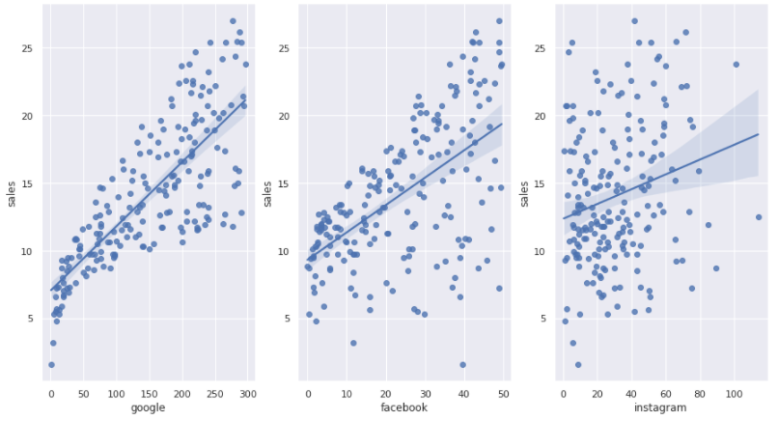
Regression Model
Sales = 0.0475 expenses + 7.03
Model score = 0.61
Sales = 0.2025 expenses + 9.31
Model score = 0.33
Sales = 0.0547 expenses + 12.35
Model score = 0.05

Slide 9
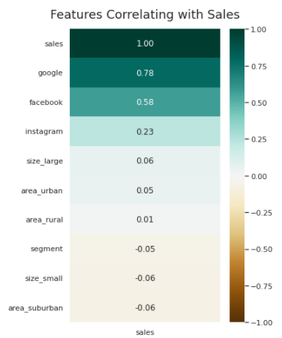
Correlation Heat Map
Top 5 high correlation with sales
Google
Facebook
Instagram
Large market
Urban area

Slide 10
Final Regression Model
Let include top 5 correlation with sales
Regression model
0.04574 google + 0.1879 facebook – 0.001 Instagram + 0.3298 Urban area + 0.0883 large area
Model score = 0.90

